Slide 1
Probability and Statistical Inference
Introduction

Slide 2
What is the module about?

Slide 3
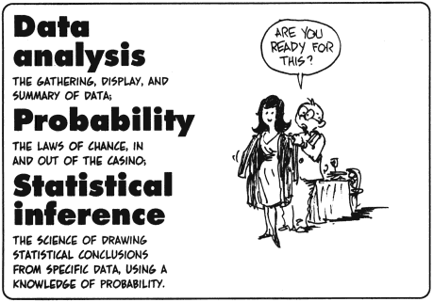
For the purposes of this module…

Slide 4
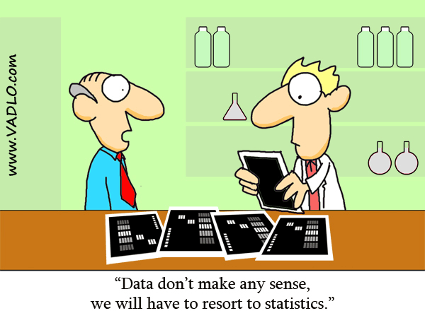

Slide 5
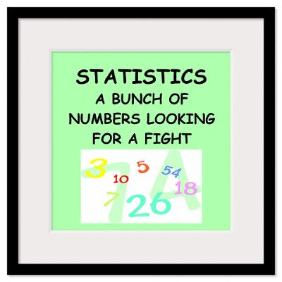

Slide 6
What is the module about?
For the purposes of a Statistical Inquiry
How to collect and prepare data for use
How to describe the data (in terms of format and statistically)
How to formulate, state, test and report on hypotheses
How to conduct exploratory and predictive analytics
How to use an appropriate software package
We will be using R
How to report your findings correctly

Slide 7
How to succeed in the module
Work steadily through the material
Keep up
Make use of the lab time allocated to work on CA
Make your own notes
On the topics we cover in class
On how to use the software
Make comments in your scripts/output and save it somewhere
Don’t be afraid to ask questions
Of me, of each other, on the web…
Keep going…

Slide 8
How to succeed in the module
Focus on learning the process of conducting a statistical analysis
What are you trying to discover or show?
Figure out a question you are trying to answer/theory you are trying to test
What data do you need to collect?
Once you have data, how do you describe the data you have?
You need to explain this to whoever will be the consumer of your work
What analysis should you conduct?
You need to know the types of tests to run and how to explain this to your consumer
How do you interpret your analysis?
You need to know how to interpret the outcomes of the analysis and present these to your consumer
How will you present your findings?

Slide 9
At the end of the module, you will be able to
Present the question you are interested in
In a way that makes sense to conduct a statistical analysis
Inspect and prepare the data you have
To support a statistical analysis
Describe the data you have
In a way that your consumer can understand any constraints the data may put on your analysis
Conduct a statistical analysis
Using appropriate statistical tests
Report on your statistical analysis
In a way that makes sense for your consumer
Interpret the outcomes of your statistical analysis
Drawing appropriate conclusions
Report on the findings of your statistical analysis
In a way that makes sense for your consumer

Slide 10
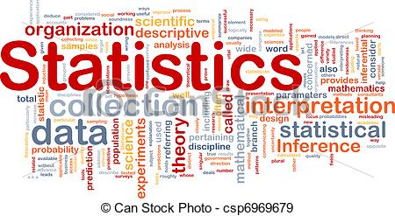

Slide 11
General Information

Slide 12
Module Material
Class material
Available via Webcourses http://www.dit.ie/lttc/webcourseslogin/student/
Help with Webcourses and how to enrol is available at http://www.dit.ie/lttc/webcourseslogin/student/

Slide 13
DT228A
The module description is
Introduction to key concepts required to conduct a statistical research inquiry for MSc students within the School of Computing and PhD students within the DIT.
The moduleID is
MATH9100-A: Probability and Statistical Inference
You need a code to register
PSIA2018

Slide 14
DT228B & DT9231 & PhD
The module description is
Introduction to key concepts required to conduct a statistical research inquiry for MSc students within the School of Computing and PhD students within the DIT.
The moduleID is
MATH9100-B: Probability and Statistical Inference
You need a code to register
PSIB2018

Slide 15
General Updates
Information about class location, times lecture and lab content, preparation, tools, assessments etc. will be made
Via Webcourses Announcements
And through email from Webcourses (to your DIT email accounts)
Blog will used for very short notice changes if any occur

Slide 16
Module Material
Lecture notes and lab exercises
Will be available in advance of classes
Please Note:
Lecture notes are intended to be a supplement to attending lectures not a replacement
Lab solutions will be published after the classes are completed

Slide 17
Assessment
Will be made available via Webcourses
Must be submitted via Webcourses

Slide 18
Assessment
PhD Students
100% Continuous Assessment to achieve Pass/Fail Grade
PGCert/MSc Students
50% End of Semester Examination (2 hours)
Previous papers will be made available in advance
Only interested in those from 2015 and later if searching online repository
50% Continuous Assessment
Will receive actual marks for both elements plus combined overall result.
PGCert/MSc and PhD
Students will have slightly different continuous assessment specification in order to reflect difference in levels of study

Slide 19
Continuous Assessment
Will be made available in Week 3
First submission due mid-semester (Week 7)
Second submission due at the end of the semester (Week 11)
You will have time to work on the assignment during class

Slide 20
House Keeping
Temporary web page
While people are waiting to register
https://tinyurl.com/lawless2018
Click on PSI2018 at top right hand side of screen
All material will be available there for a couple of weeks
If you still require special access after week 3 you will need to email me to request it

Slide 21
Classes
Wednesday
DT228A Full Time
14.00 KA-3-022 Lecture
Followed by lab in KA-3-006 or KA-3-008 (start time 15.30/16.00) depending on topic
DT228B/DT9231 Part Time
18.30 KE-B-016
Mixture of lecture and lab
If we need to move room due to Wi-fi issues we have labs allocated.

Slide 22
House Keeping
Best way to contact me
Email: deirdre.lawless@dit.ie
Or talk to me during class.

Slide 23
Software
R and R Studio

Slide 24

Discovering Statistics with R – Field, Miles & Field
2 copies in library
Available from:
Amazon
Datasets and R scripts available at
https://studysites.uk.sagepub.com/dsur/study/default.htm

Slide 25
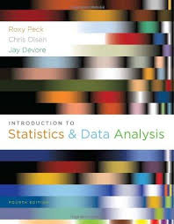
Introduction to Statistics and Data Analysis – Peck, Olsen & Devore
Available from:
Amazon
Lots of copies available in DIT library

